Slide 1
Introduction to Statistics for Ecology and Evolutionary Biology Statistical Distributions and Summary Statistics Week 05 24 February 2020

Slide 2
Probability Distributions
Discrete probability distributions
Possible outcomes are discrete events
Have an associated probability mass function (pmf)
Summation over the valid values of the pmf yields 1
Continuous probability distributions
Possible outcomes are values within a continuous range
Have an associated probability density function (pdf)
Integration over the full interval of the pdf yields 1
Notes:
Probability distributions will play a major role within our models since they are our tools used to define priors and likelihoods
Thus they are critical to generating posterior inference

Slide 3
Binomial Distribution
A discrete probability distribution with two parameters:
n = number of trials, p = probability of success
Outcome is the number of successes (x) in n trials with probability of success p
The probability mass function in R:
dbinom(x, size, prob)
Where x = the number of successes, size = n, prob = p
The random generation function in R:
rbinom(n, size, prob)
Where n = the number of observations to generate, size = n, prob = p
Notes:
Note how the word “parameter” is used here to describe the defining characteristics of a statistical distribution
So parameters define a statistical distribution, and we are interested in estimating these parameters to answer ecological questions
Note the confusion that might arise with the “probability of success” parameter here in the binomial distribution
This is a parameter we’re trying to estimate
So a posterior distribution for the probability of success parameter (p) shows us the relative probability of different probability of success values
This is all rather meta, so take some time to let it sink in
Note that the parameters within a discrete probability distribution can be continuous

Slide 4
Binomial Distribution: Ecological Examples
Infection or disease (yes/no)
Survival (survived/died)
Occurrence (occupied/unoccupied)
Notes:
Data that are commonly expressed as proportions are often modeled as binomial events
http://capitalnaturalist.blogspot.com/2017/10/mangy-foxes.html

Slide 5
Binomial Distribution: Visualized
Notes:
These are the probability mass functions for three different binomial distributions
Show sample code demonstrating dbinom(), plotting, and rbinom()
https://en.wikipedia.org/wiki/Binomial_distribution#/media/File:Binomial_distribution_pmf.svg

Slide 6
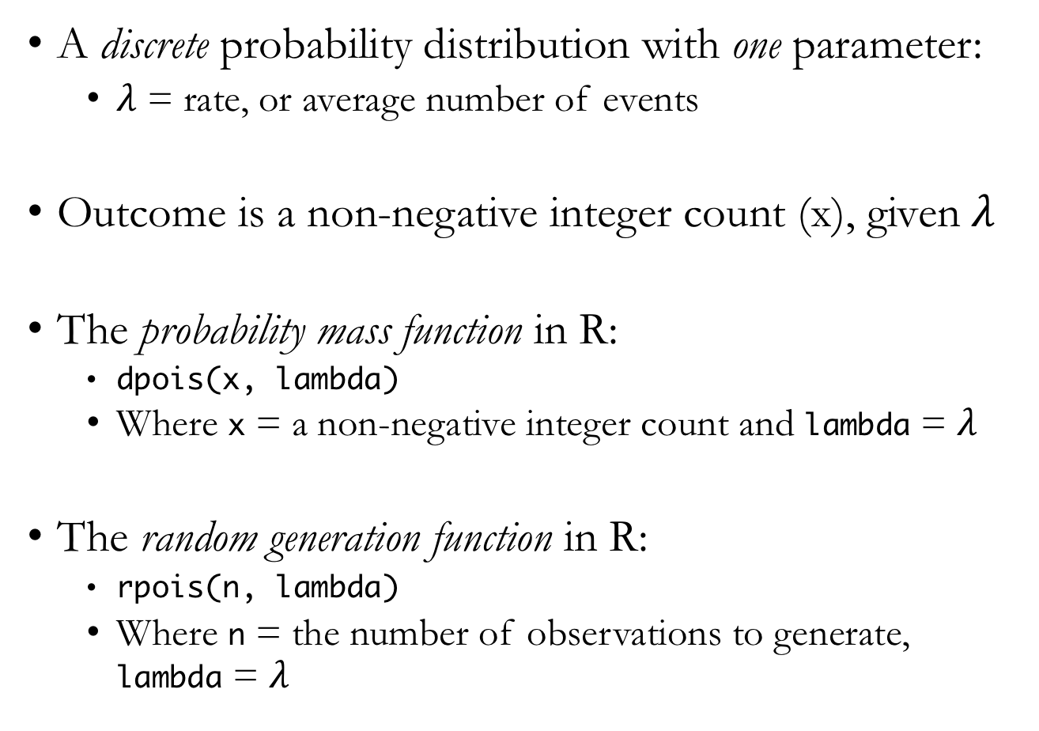
Poisson Distribution
A discrete probability distribution with one parameter:
$λ$ = rate, or average number of events
Outcome is a non-negative integer count (x), given $λ$
The probability mass function in R:
dpois(x, lambda)
Where x = a non-negative integer count and lambda = $λ$
The random generation function in R:
rpois(n, lambda)
Where n = the number of observations to generate, lambda = $λ$

Slide 7
Poisson Distribution: Ecological Examples
Notes:
Any sort of organismal count data might be reasonably modeled as Poisson distributed
http://www.vernalpools.me/wp-content/uploads/2015/06/5_VernalPool_6411764_orig.jpg

Slide 8
Poisson Distribution: Visualized
Notes:
These are the probability mass functions for three different Poisson distributions
https://en.wikipedia.org/wiki/Binomial_distribution#/media/File:Binomial_distribution_pmf.svg

Slide 9
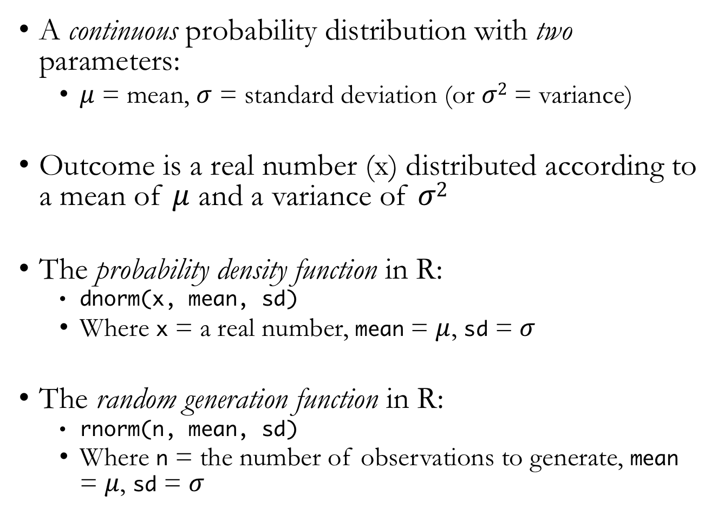
Normal Distribution
A continuous probability distribution with two parameters:
$μ$ = mean, $σ$ = standard deviation (or $σ2$ = variance)
Outcome is a real number (x) distributed according to a mean of $μ$ and a variance of $σ2$
The probability density function in R:
dnorm(x, mean, sd)
Where x = a real number, mean = $μ$, sd = $σ$
The random generation function in R:
rnorm(n, mean, sd)
Where n = the number of observations to generate, mean = $μ$, sd = $σ$
Notes:
Also called the Gaussian distribution
Greek letter “mu” for the mean parameter, “sigma” for the standard deviation parameter

Slide 10
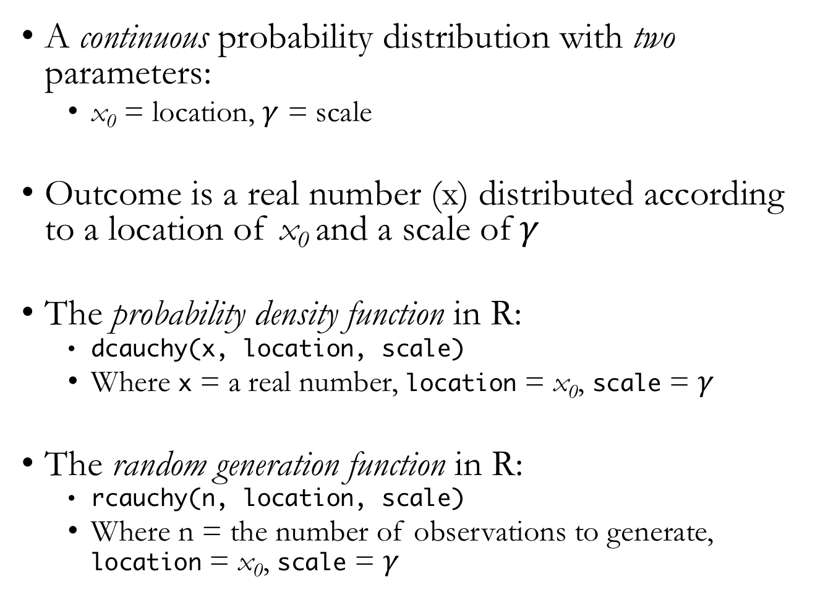
Cauchy Distribution
A continuous probability distribution with two parameters:
x₀ = location, $γ$ = scale
Outcome is a real number (x) distributed according to a location of x₀ and a scale of$γ$
The probability density function in R:
dcauchy(x, location, scale)
Where x = a real number, location = x₀, scale = $γ$
The random generation function in R:
rcauchy(n, location, scale)
Where n = the number of observations to generate, location = x₀, scale = $γ$
Notes:
Relative to the normal distribution, the Cauchy distribution has much fatter tails, making values far from the “location” more likely
Greek letter “gamma” for the scale parameter

Slide 11
Continuous Data: Ecological Examples
Mass, height, and numerous other organismal characteristics
Distance
Environmental data like temperature and precipitation
Notes:
https://www.mdpi.com/remotesensing/remotesensing-08-00388/article_deploy/html/images/remotesensing-08-00388-g002.png

Slide 12
Normal Distribution: Visualized
Notes:
These are the probability density functions for four different normal distributions
https://en.wikipedia.org/wiki/Normal_distribution#/media/File:Normal_Distribution_PDF.svg

Slide 13
Cauchy Distribution: Visualized
Notes:
These are the probability density functions for four different Cauchy distributions
Show sample code comparing pdfs for both the normal and Cauchy distributions
https://en.wikipedia.org/wiki/Cauchy_distribution#/media/File:Cauchy_pdf.svg

Slide 14
Thinking with Samples
Consider working with distributions and samples as a translational process that can flow back and forth
We can draw samples from a distribution
Samples are often simpler to work with, allow for easy posterior summary
And some methods for Bayesian inference only produce posterior samples
We can also visualize the distribution of our samples
Notes:
Show sample code generating samples from a grid approximate posterior distribution

Slide 15
Summarizing Samples: Intervals of Defined Mass
Percentile intervals
Assign equal probability mass to each interval tail
So provides the central X% probability interval
Highest posterior density intervals
The narrowest interval containing a given probability mass
Notes:
Percentile intervals are also what are commonly known as “credible intervals” in Bayesian contexts

Slide 16
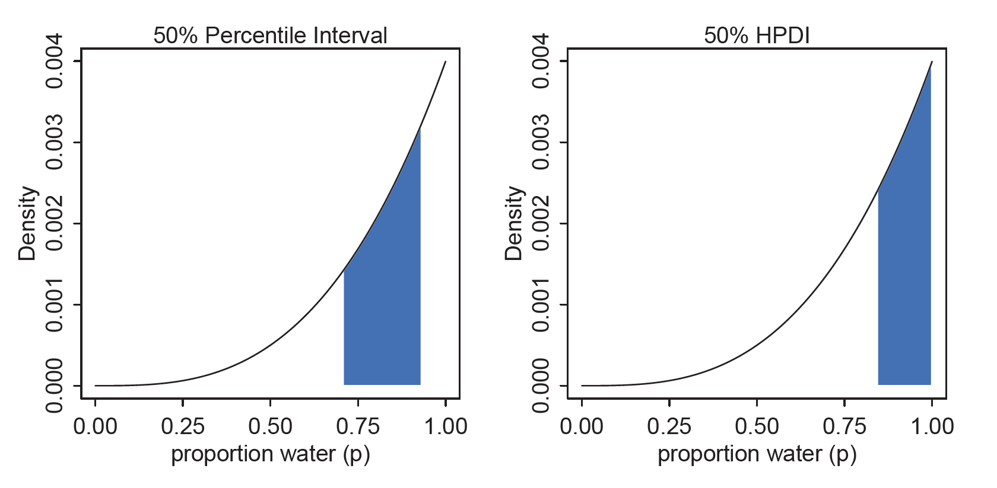
Summarizing Samples: Intervals of Defined Mass
McElreath 2016, Statistical Rethinking
Notes:
Percentile intervals can be misleading in cases with highly skewed posteriors
Show sample code calculating these intervals

Slide 17
Summarizing Samples: Measures of Central Tendency
Mean
The average value
Median
The middle value (aka the 50th percentile)
Mode
The most frequent value
Notes:
These are also known as “point estimates”

Slide 18
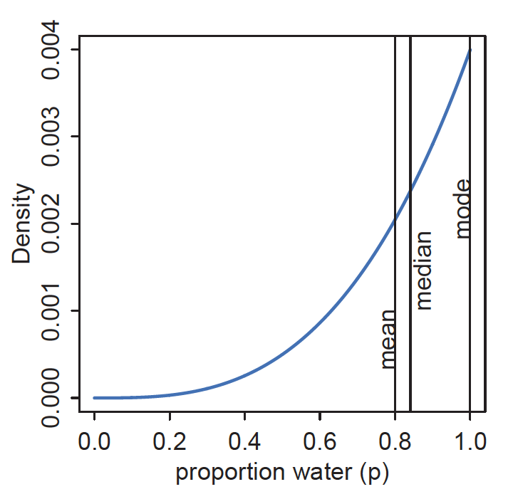
Summarizing Samples: Measures of Central Tendency
McElreath 2016, Statistical Rethinking
Notes:
For highly skewed distributions, the mean, median, and mode can be quite different
For roughly bell-shaped distributions (like a normal distribution), they will be quite similar

Slide 19
Keep in Mind
In Bayesian inference, the posterior distribution (in its entirety) is the statistical “estimate”
Intervals and point estimates are simply ways to summarize the posterior
It is often preferable to show the entire posterior distribution for a given parameter
Notes:
Just as we often want to show the raw data whenever possible with data visualization, we often want to show the entire posterior distribution rather than a single summary metric

Slide 20
Sampling to Simulate Prediction
Samples from our model can also be used to help us generate model predictions
Critically, we have to account for two major sources of uncertainty in our predictions
Parameter uncertainty
Observation uncertainty
When we properly account for these sources of uncertainty in our predictions, we have a posterior predictive distribution
Notes:
Parameter uncertainty: uncertainty about what the true parameter values are
Observation uncertainty: uncertainty about outcome even given a fixed parameter value

Slide 21
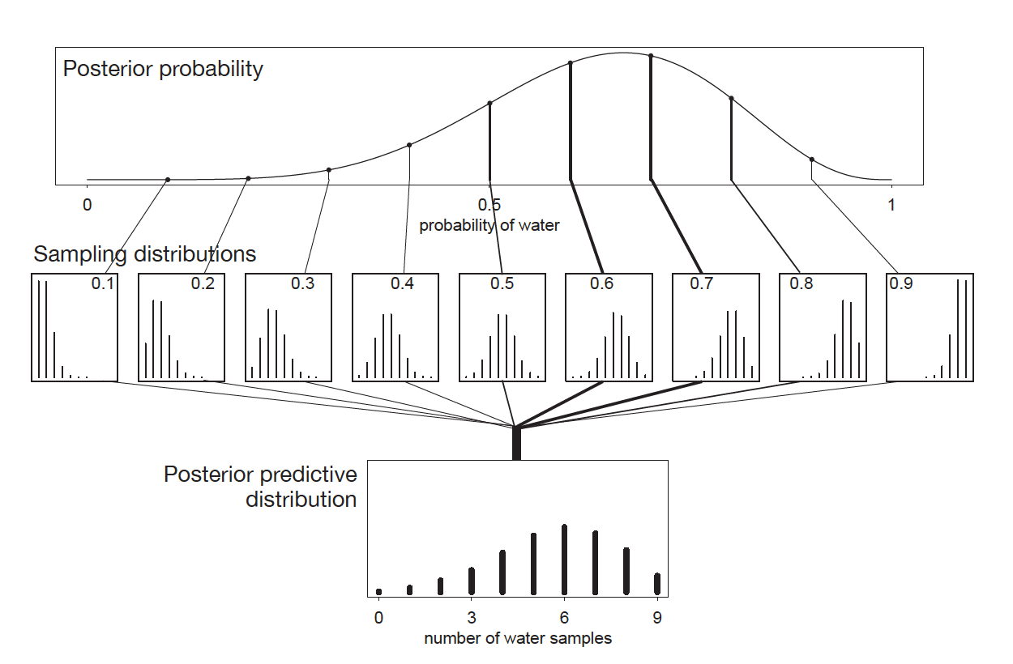
McElreath 2016, Statistical Rethinking

